Slide 1

Brain inspired computing
using a FPAA Board
1st week catch-up session
Getting to know the board & its environment by building a simple on chip LPF
Matthieu Divet
Jonathan Gomis
Special problem
ECE 8903
Dr. Alexandre Locquet
Dr. Damien Rontani

Slide 2
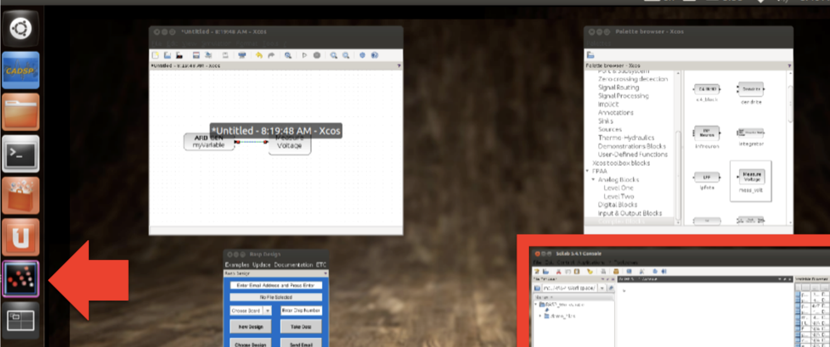
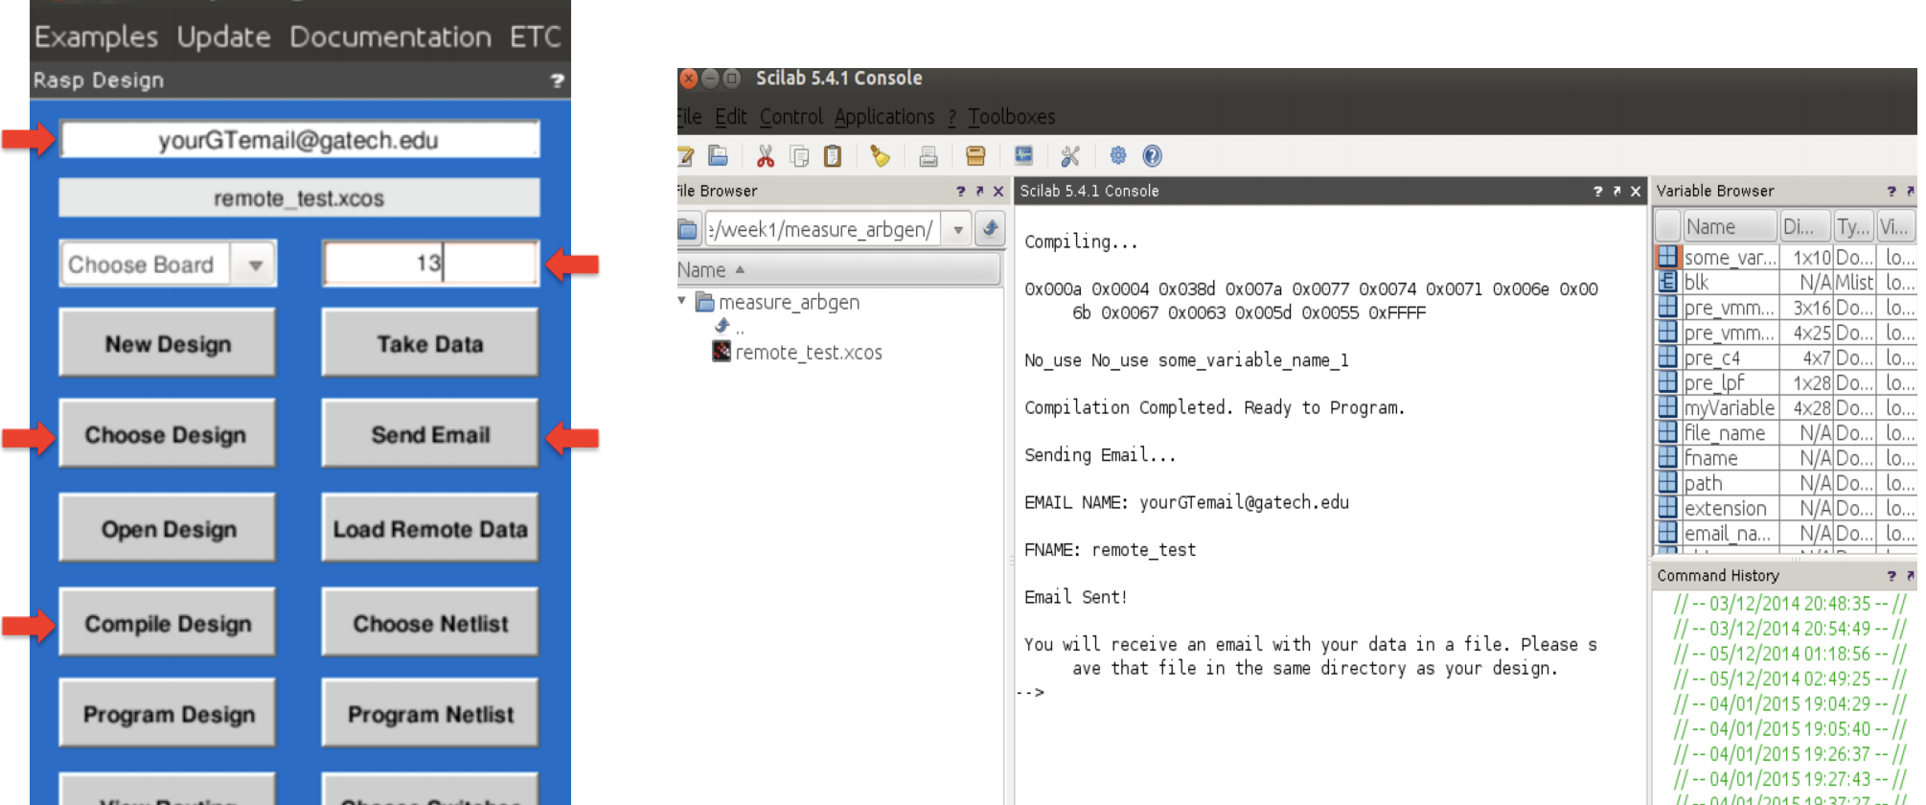
Setting up the virtual machine and creating our first design
Followed instructions in:
Dr. Hasler’s tutorial Becoming Familiar with the RASP Tools Suite for FPAAs, and;
FPAA for Dummies.
No major problem
Testing a design on Dr. Hasler’s remote FPAA Board
Unsuccessful
We first tried using it with the same board version as the one we have at GTL (3.0 A): seemed to work but we never received any email…
After this attempt, the console indicated that the board version 3.0 should be used
With the 3.0 version, the ”Send Email” function threw errors
Also, “Send Email” asks for an email and a password. Which one?

Slide 3
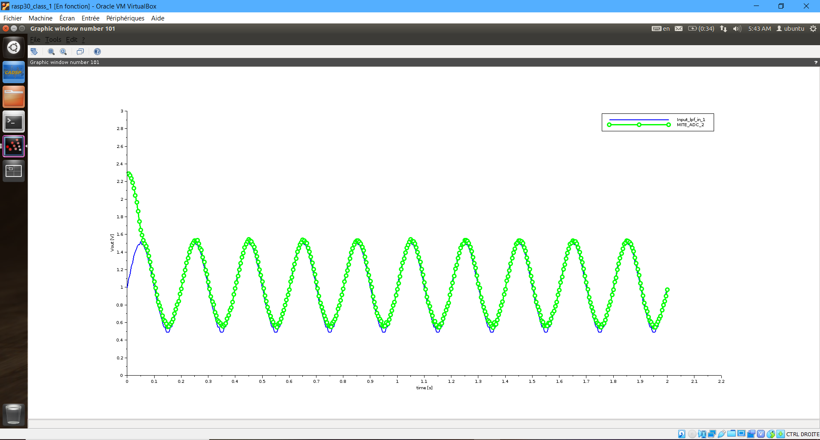
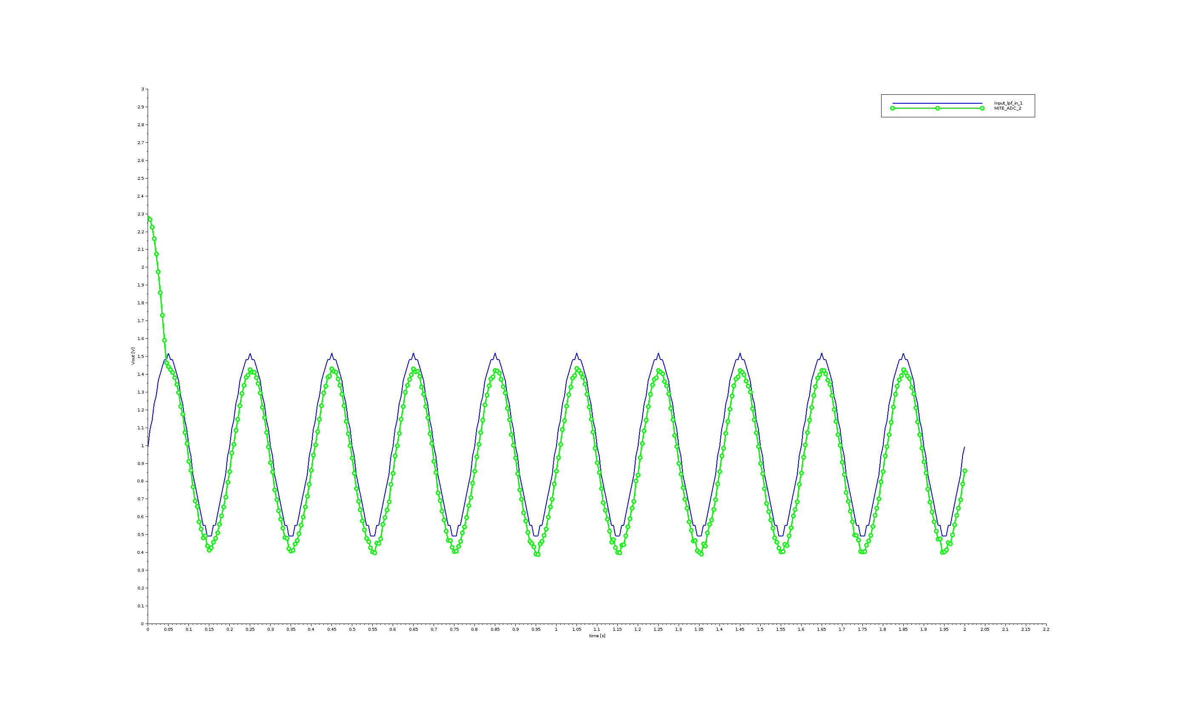

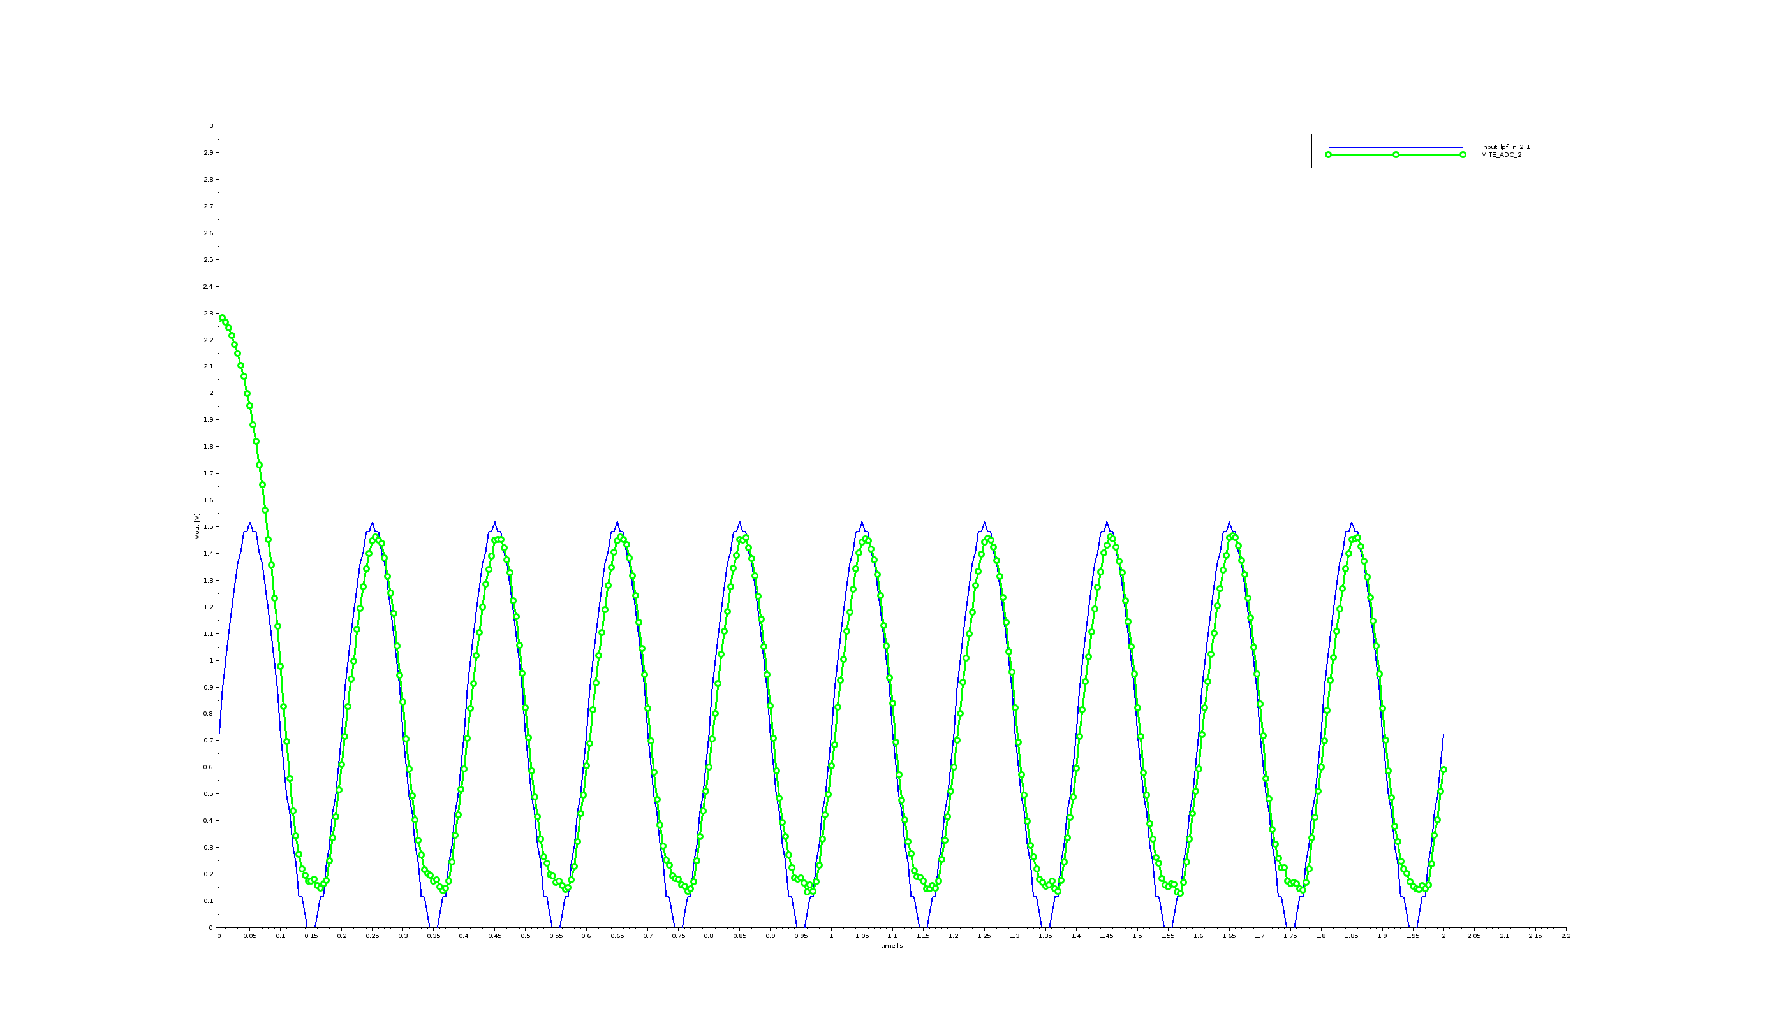
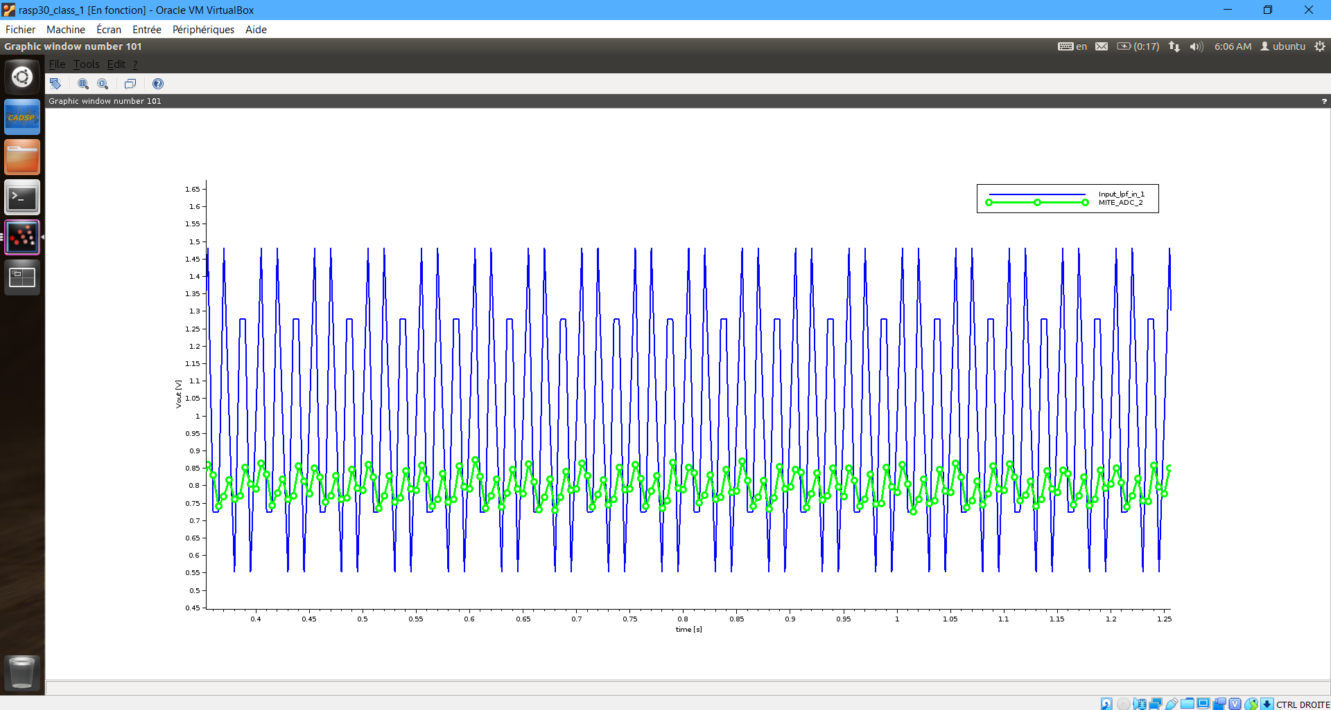
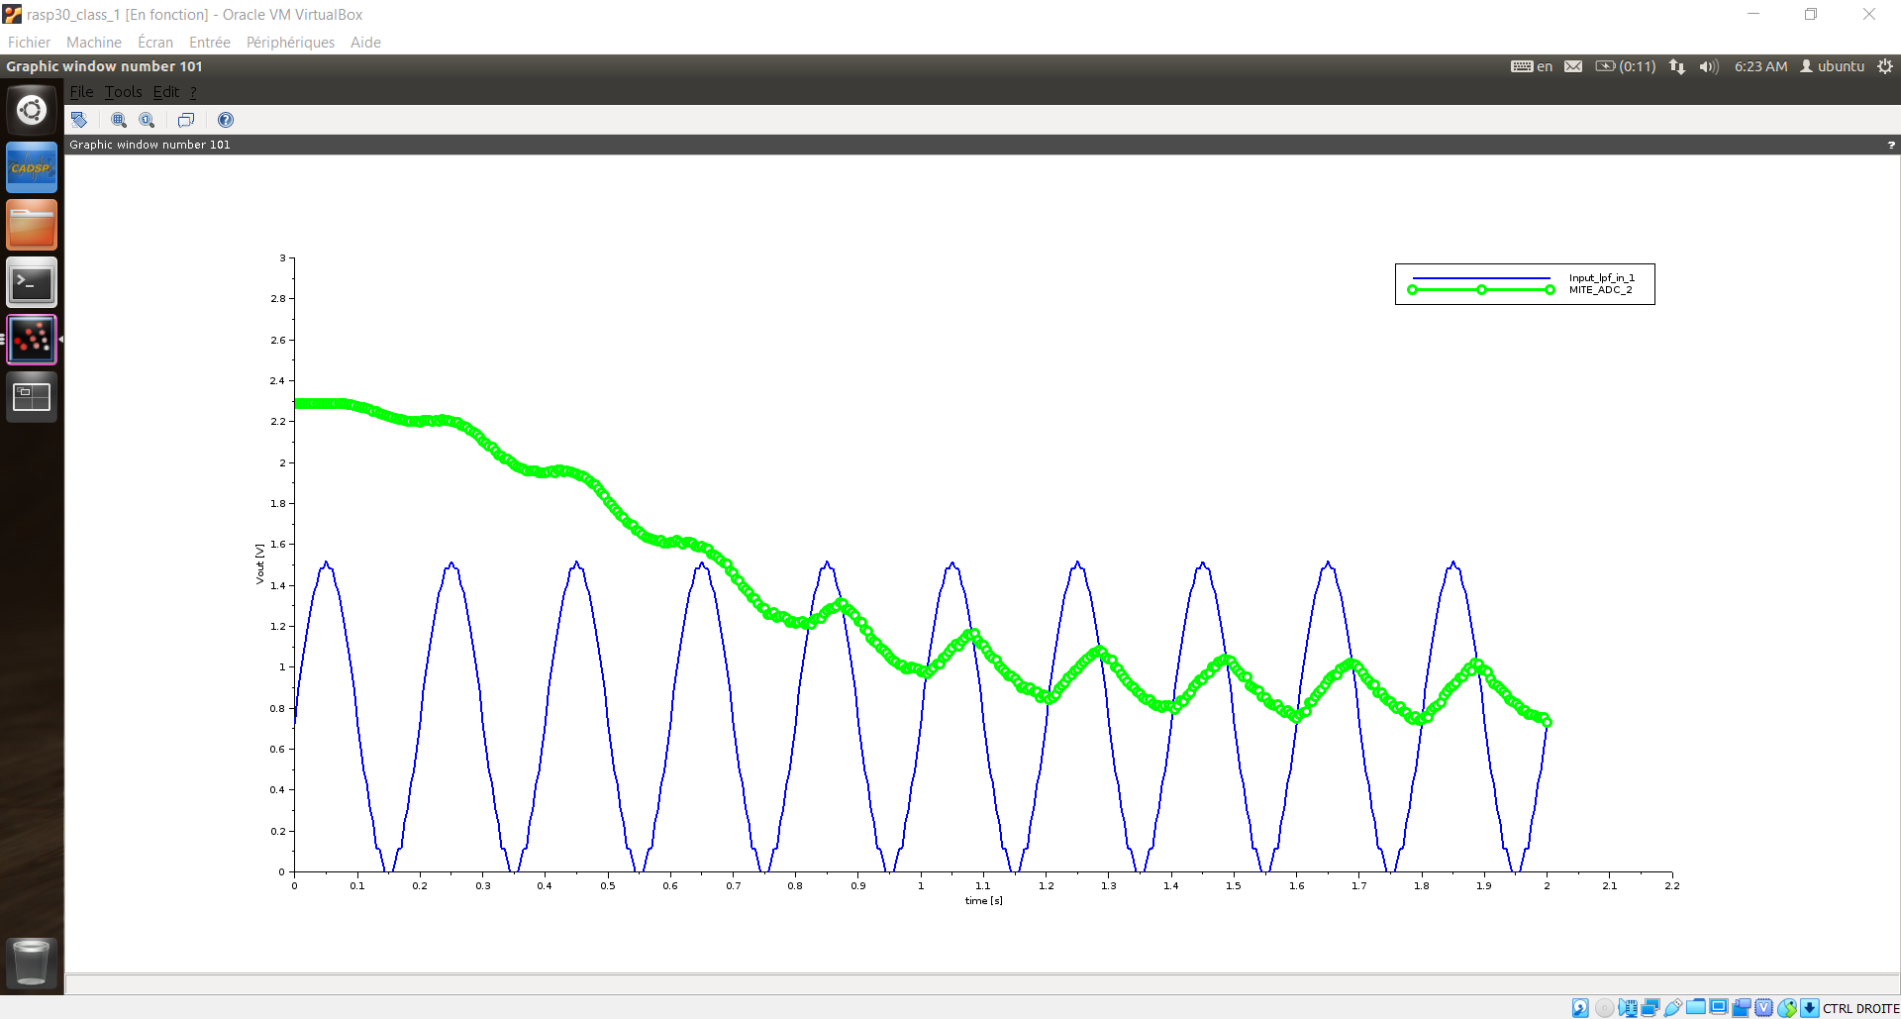
1) Jonathan’s results
1) Matthieu’s results
Testing an on-chip LPF design on our FPAA Board
Followed the instructions left by last year’s students in the document FPAA for Dummies
Used the on-chip LPF design available in the Examples
Performed several tests by changing some parameters:
Signal_freq = 5Hz; Cut-off_freq = 108.5Hz; Sample_rate = 200Hz; Signal_offset = 1V; Signal_amp = 0.5V
Signal_freq = 5Hz; Cut-off_freq = 108.5Hz; Sample_rate = 100Hz; Signal_offset = 1V; Signal_amp = 0.5V
Signal_freq = 5Hz; Cut-off_freq = 108.5 Hz; Sample_rate = 200Hz; Signal_offset = 0.75V; Signal_amp = 0.75V
Signal_freq = 60Hz; Cut-off_freq = 50Hz; Sample_rate = 200Hz; Signal_offset = 1V; Signal_amp = 0.5V
Signal_freq = 5Hz; Cut-off_freq = 2.5 Hz; Sample_rate = 200Hz; Signal_offset = 0.75V; Signal_amp = 0.75V
2)
3)
5) Jonathan’s and Matthieu’s results were identical
4)

Slide 4
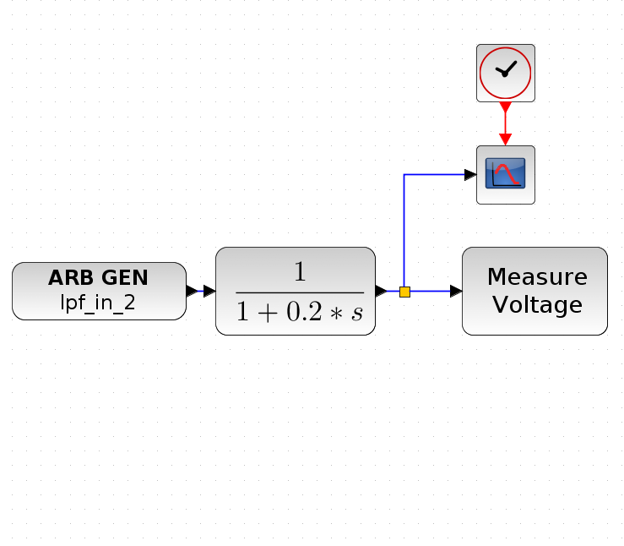
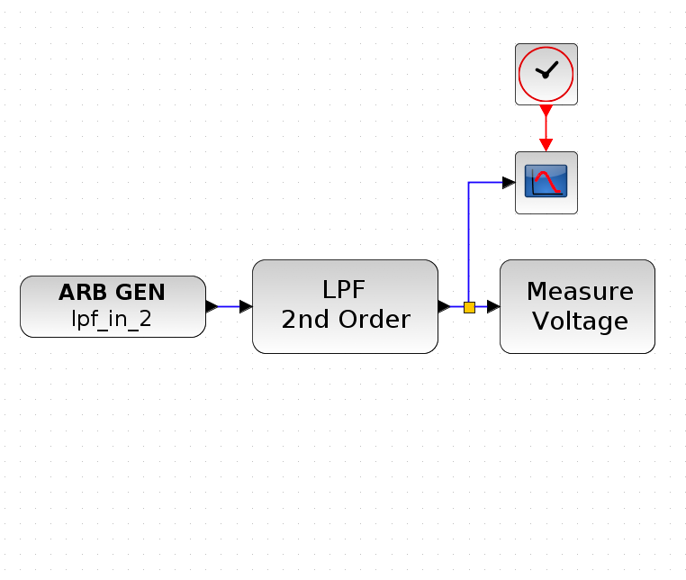
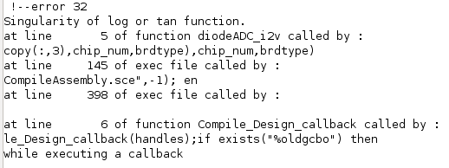
Trying a different on-chip LPF design on our FPAA Board
We first tried replacing the black-box design given in the FPAA palette by a simple CLR model with T = 0.2s
Unsuccessful because the program couldn’t compile the block from the traditional Xcos palette for the CLR model
We tried using the LPF 2nd Order block available in the FPAA palette
Unsuccessful: we have some questions regarding this block as what “First/Second Stage Bias” means. Also, it threw what seems to be a Math problem for the values:
First Stage Bias = 4.00D-08
Second Stage Bias = 4.00D-08

